Slide 1
exceptions
JDBC Database Access

Slide 2
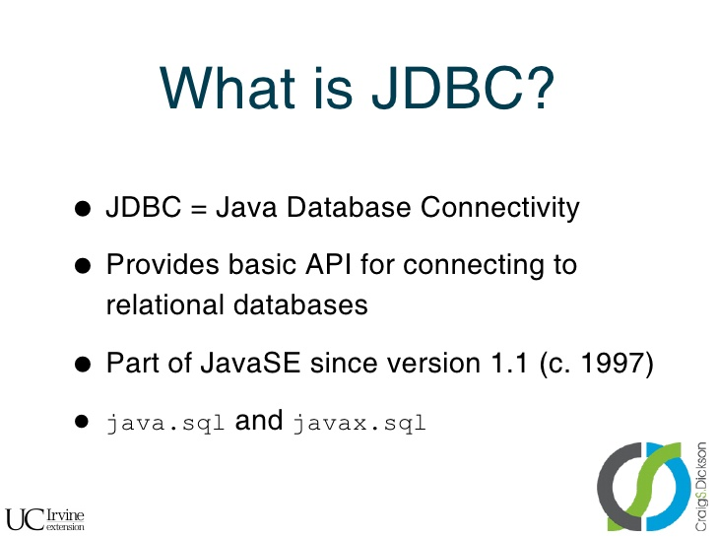

exceptions

Slide 3
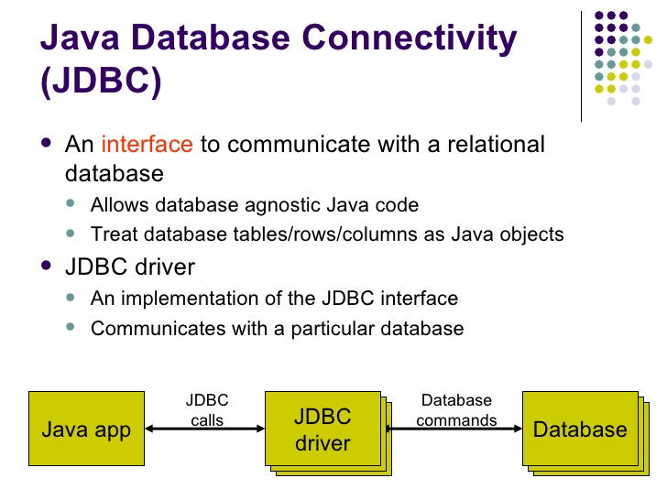
exceptions

Slide 4
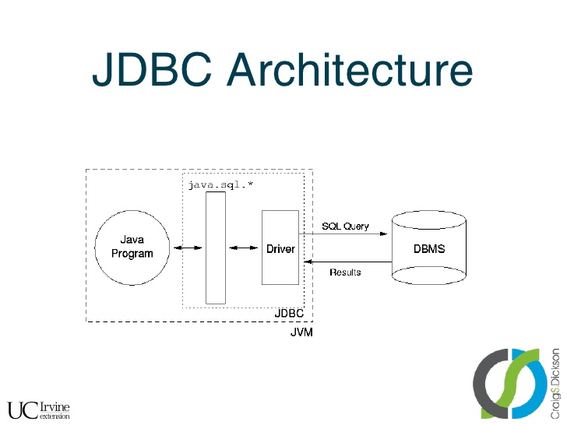
exceptions

Slide 5
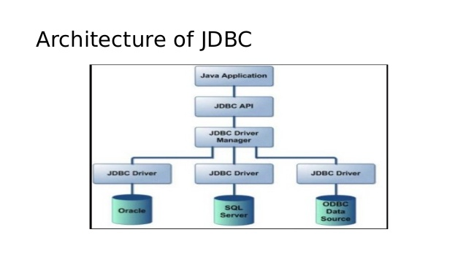
exceptions

Slide 6
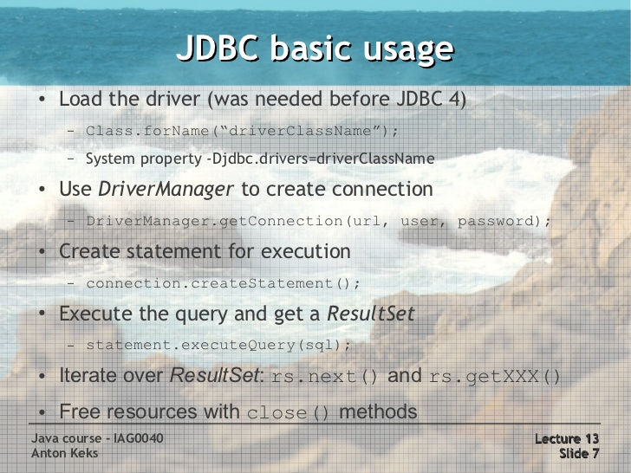
exceptions

Slide 7
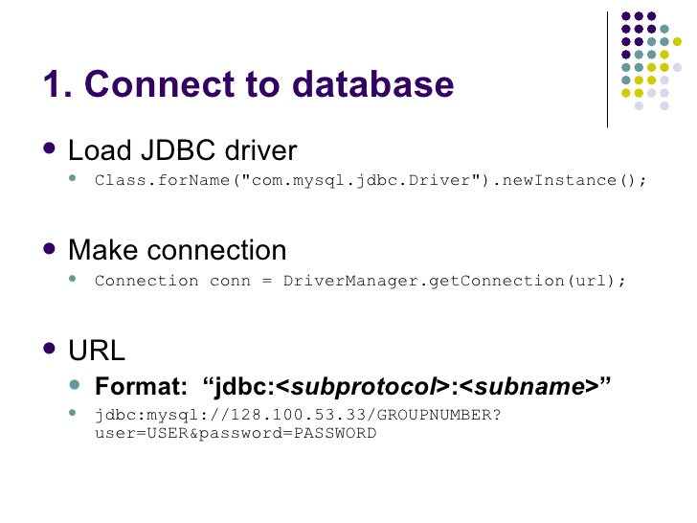
exceptions

Slide 8
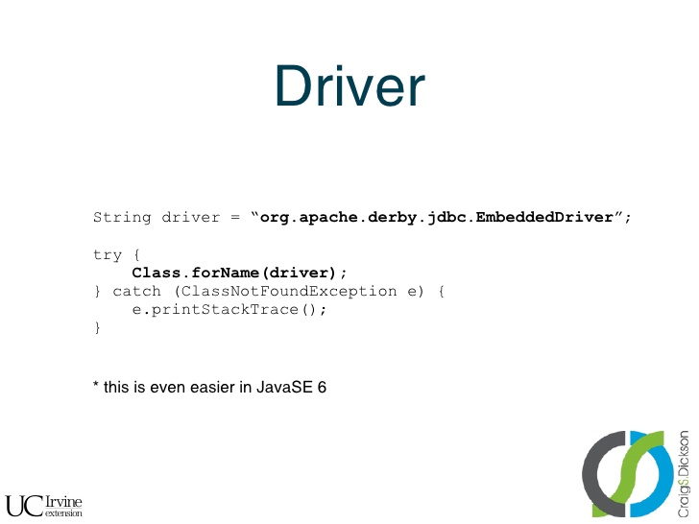
exceptions
Any JDBC 4.0 drivers that are found in your class path are automatically loaded. (However, you must manually load any drivers prior to JDBC 4.0 with the method Class.forName.)

Slide 9
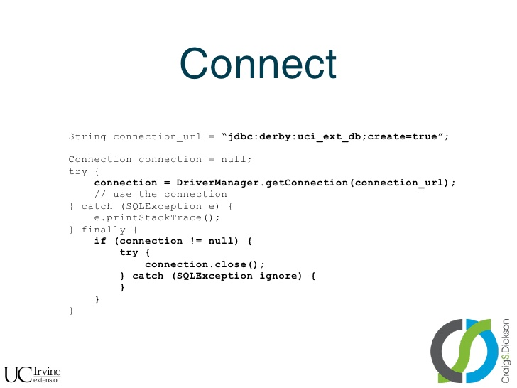
exceptions

Slide 10
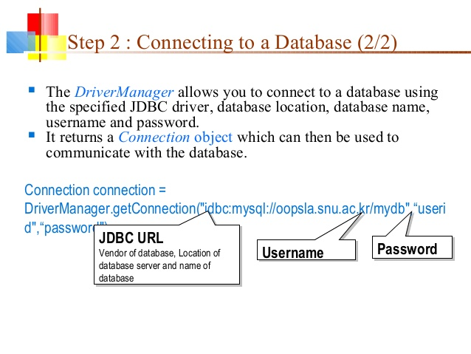
exceptions

Slide 11

exceptions
Database Connection URL’s
For Java DB:
jdbc:derby:[subsubprotocol:][databaseName] [;attribute=value]*
subsubprotocol specifies where Java DB should search for the database, either in a directory, in memory, in a class path, or in a JAR file. It is typically omitted.
databaseName is the name of the database to connect to.
attribute=value represents an optional, semicolon-separated list of attributes. These attributes enable you to instruct Java DB to perform various tasks, including the following:
Create the database specified in the connection URL.
Encrypt the database specified in the connection URL.
Specify directories to store logging and trace information.
Specify a user name and password to connect to the database.
Ex: jdbc:derby:testdb;create=true

Slide 12
exceptions
Database Connection URL’s
For MySQL:
jdbc:mysql://[host][,failoverhost...][:port]/[database][?propertyName1][=propertyValue1][&propertyName2][=propertyValue2]...
host:port is the host name and port number of the computer hosting your database. If not specified, the default values of host and port are 127.0.0.1 and 3306, respectively.
database is the name of the database to connect to. If not specified, a connection is made with no default database.
failover is the name of a standby database (MySQL Connector/J supports failover).
propertyName=propertyValue represents an optional, ampersand-separated list of properties.
Ex: jdbc:mysql://localhost:3306/mysql

Slide 13
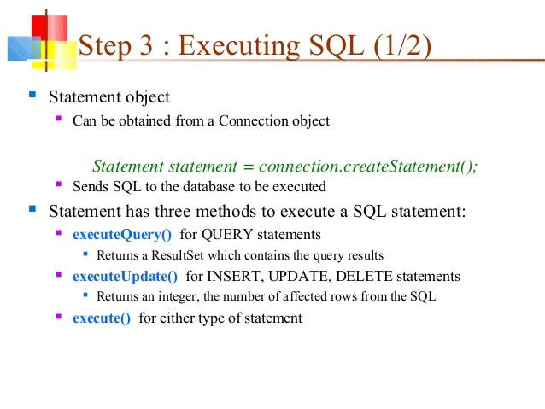
exceptions

Slide 14
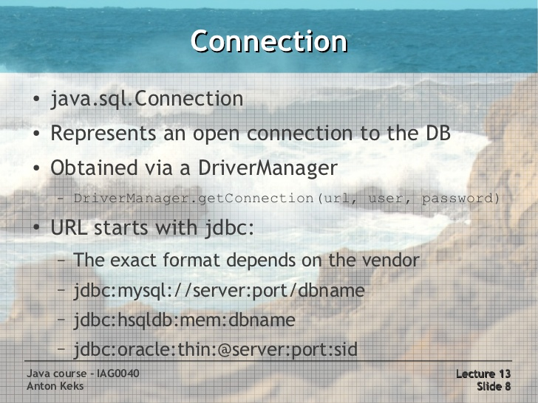
exceptions
Lab22.3: Demonstration JDBC connection to mysql db and query the table.
Lab22.4: Demonstration JDBC connection to mysql db using try with Resource statement.

Slide 15
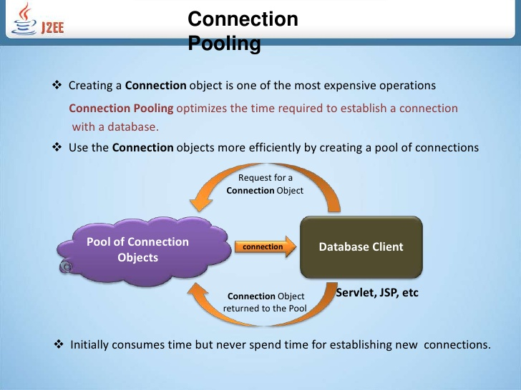
exceptions

Slide 16
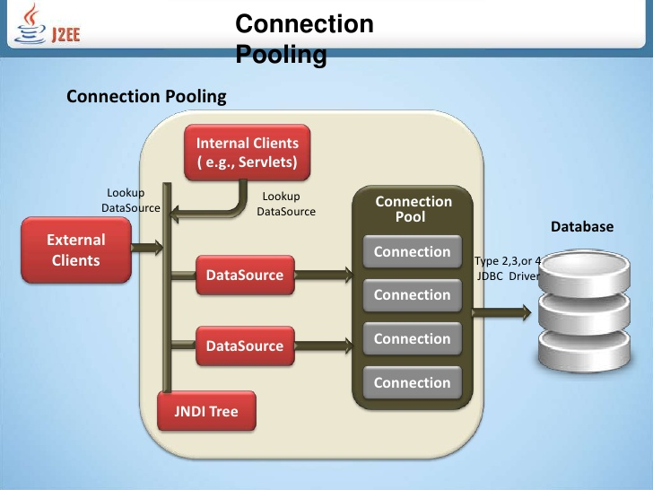
exceptions

Slide 17
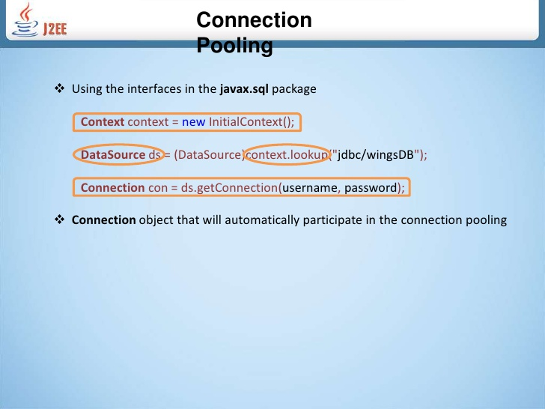
exceptions

Slide 18
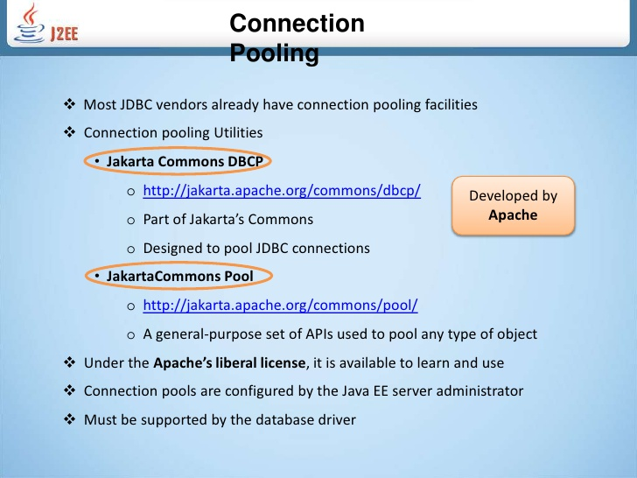
exceptions

Slide 19
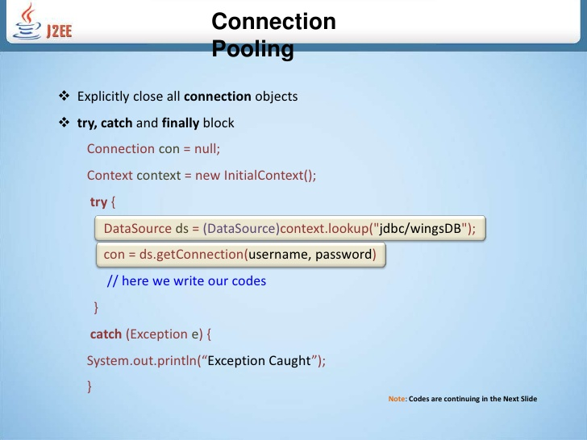
exceptions

Slide 20
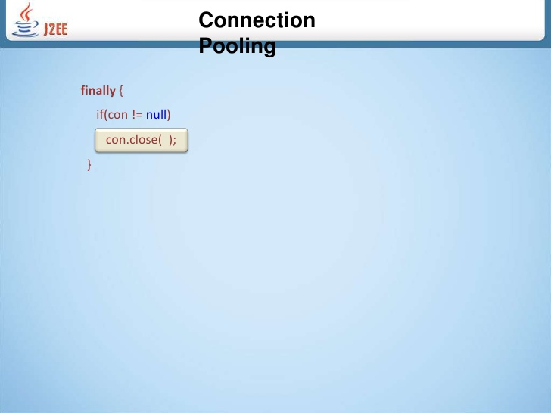
exceptions

Slide 21
exceptions
DataSource
Preferred means of getting a connection to a data source.
Provides connection pooling.
Provides distributed transactions.
A JDBC driver should include at least a basic DataSource implementation (Connection objects that are not pooled or used in distributed transactions).
Provides caching of PreparedStatement for faster processing.
Configure Connection timeout settings.
Centralized logging.
ResultSet maximum size threshold.
Enables code portability.

Slide 22
exceptions
DataSource
Ex:
For Java DB:
org.apache.derby.jdbc.ClientDataSource
For MySQL:
com.mysql.jdbc.jdbc2.optional.MysqlDataSource

Slide 23
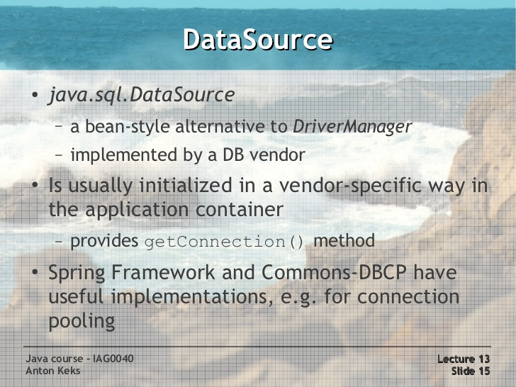
exceptions
Lab22.4: Demonstration JDBC connection to mysql db using DataSource

Slide 24
exceptions
JDBC Exceptions
JDBC throws an instance of SQLException as opposed to Exception.

Slide 25
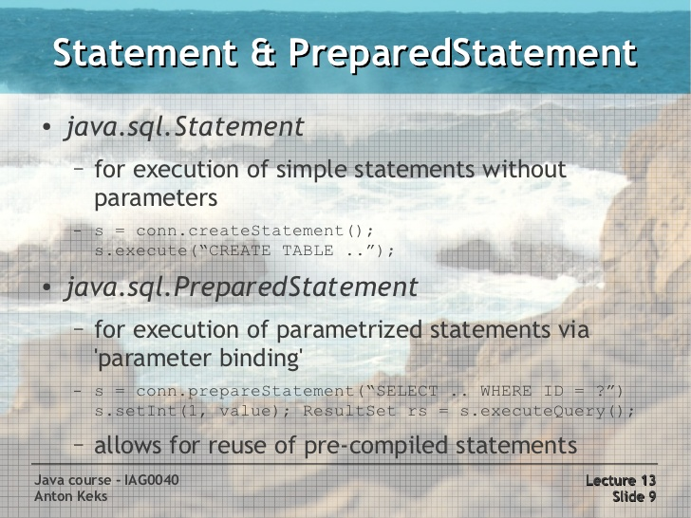
exceptions

Slide 26
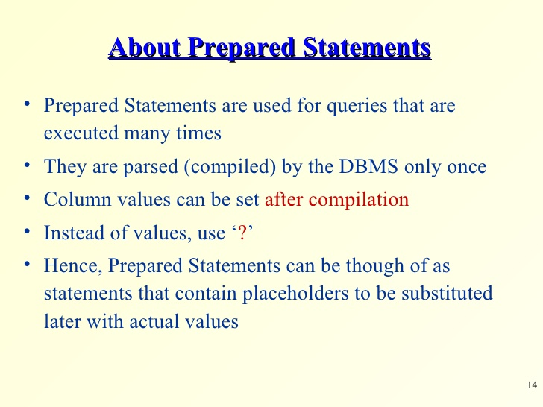
exceptions
Lab22.6: Demonstrating PreparedStatement

Slide 27
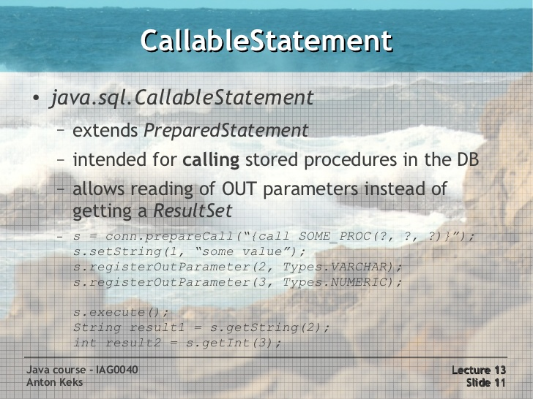
exceptions

Slide 28
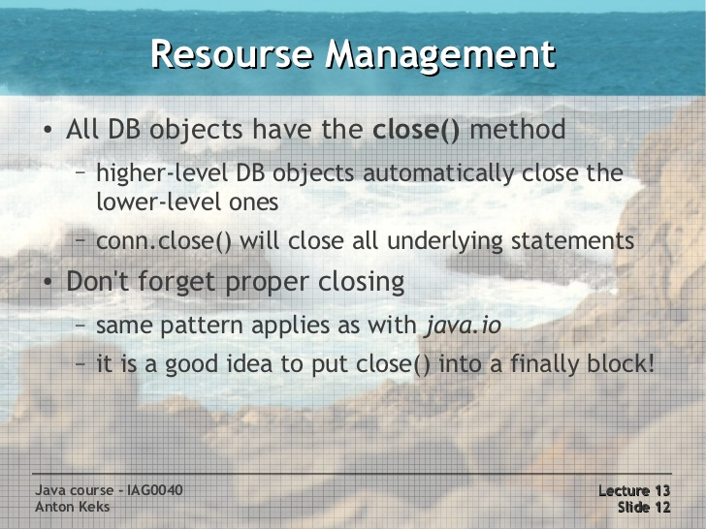
exceptions

Slide 29
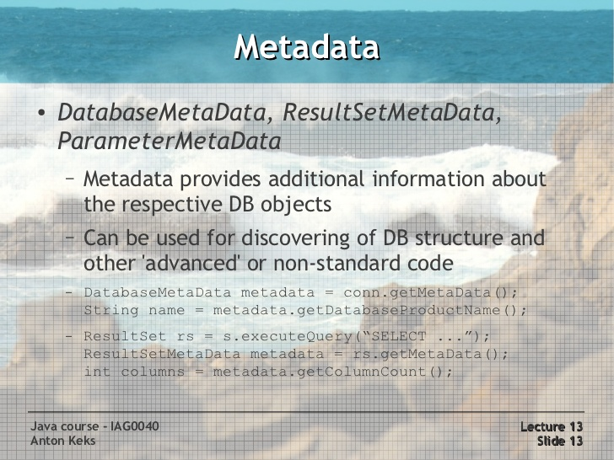
exceptions

Slide 30
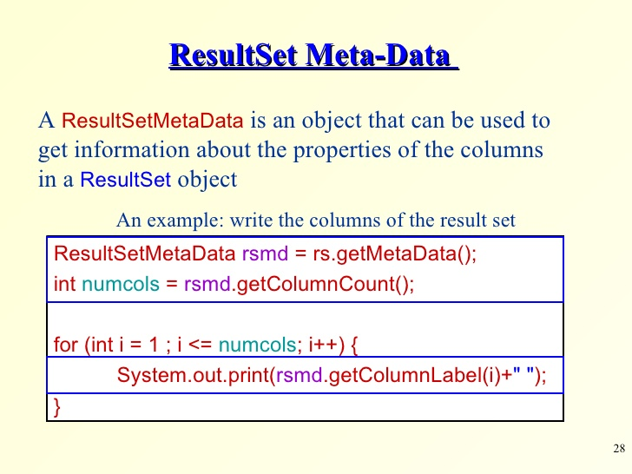
exceptions

Slide 31
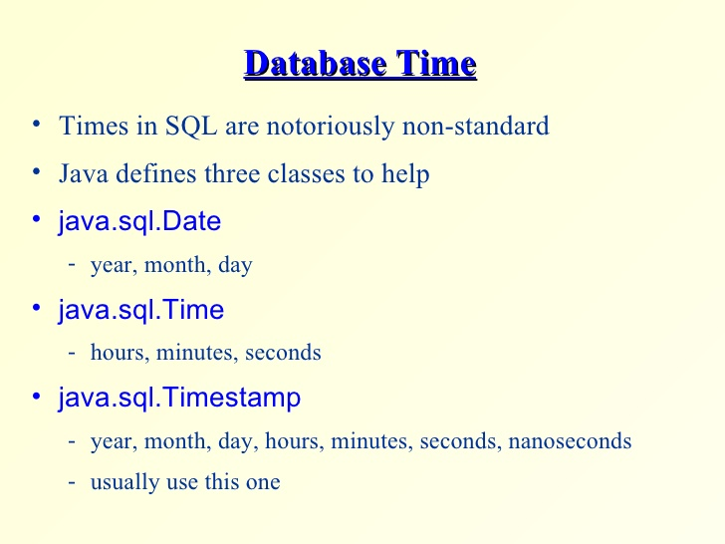
exceptions

Slide 32
exceptions

Slide 33
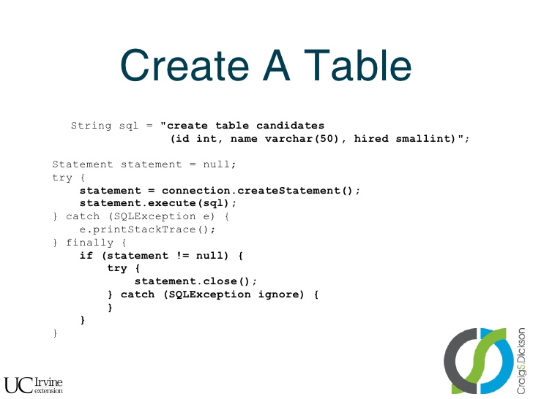
exceptions

Slide 34
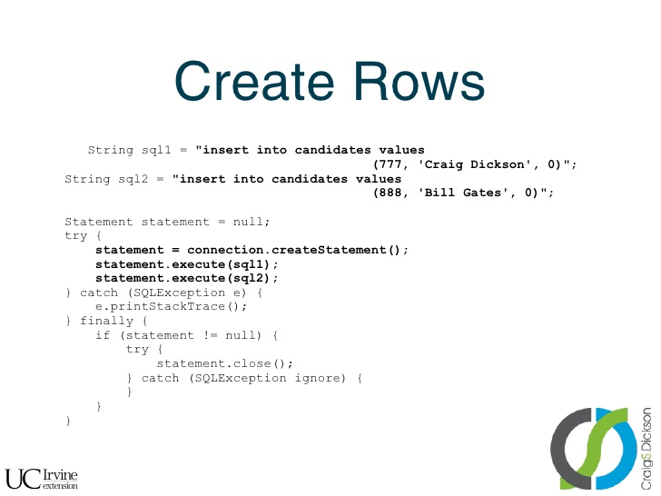
exceptions

Slide 35
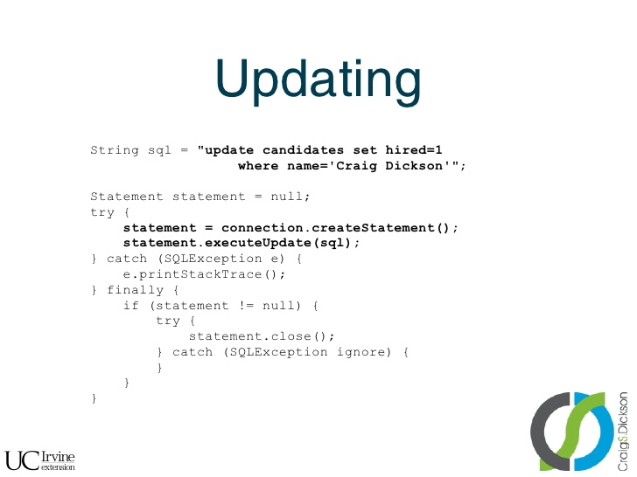
exceptions

Slide 36
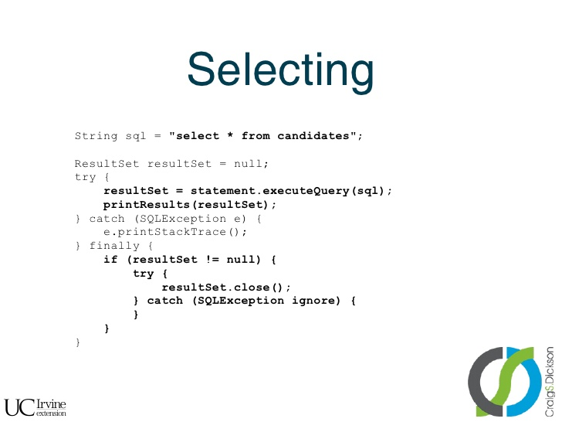
exceptions

Slide 37
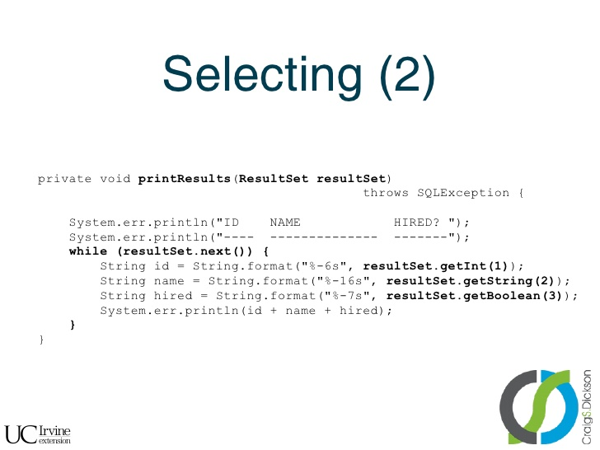
exceptions

Slide 38
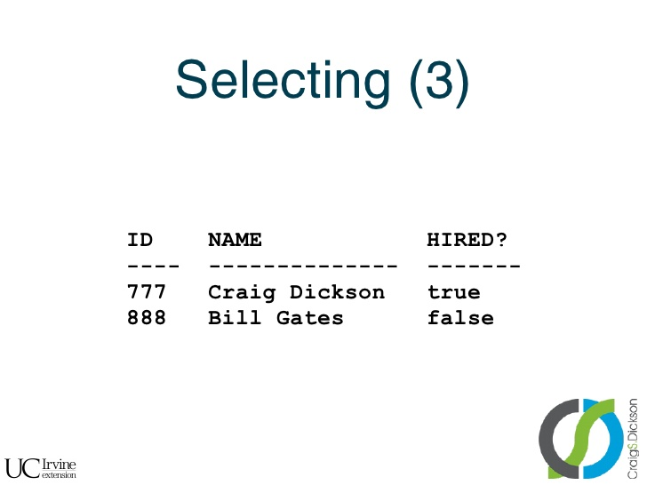
exceptions

Slide 39
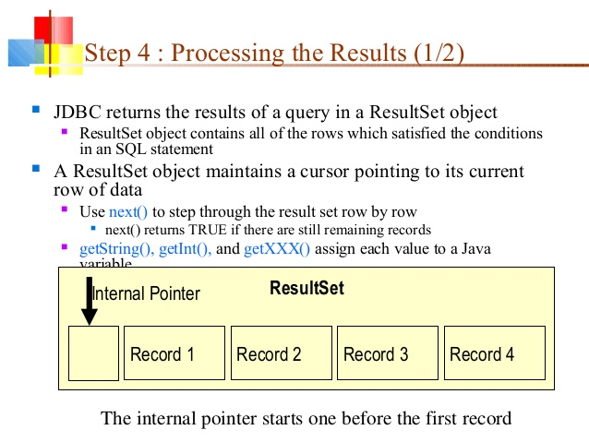
exceptions

Slide 40
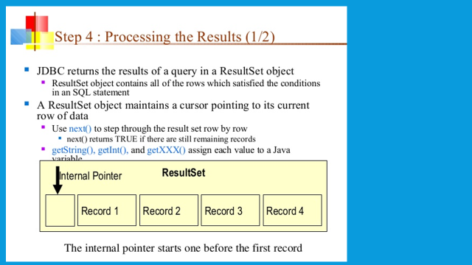
exceptions

Slide 41
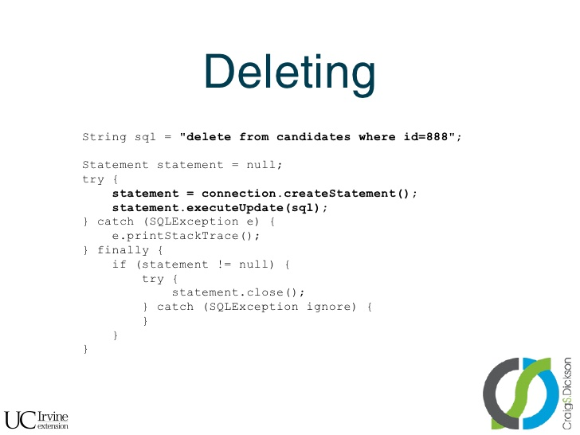
exceptions

Slide 42
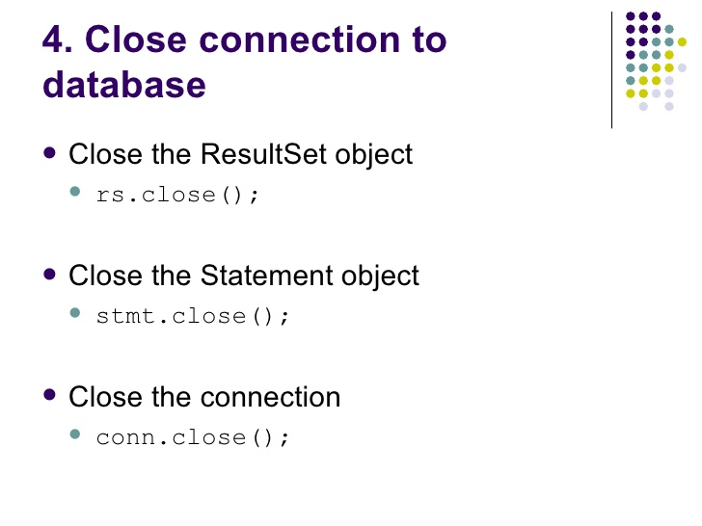
exceptions
Lab22.4: Interacting with DB using create and insert JDBC statements

Slide 43
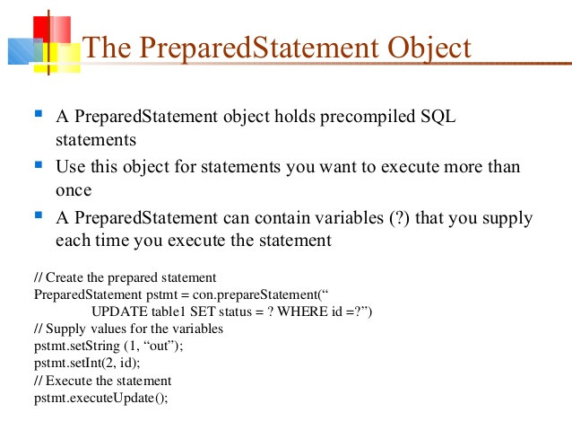
exceptions

Slide 44
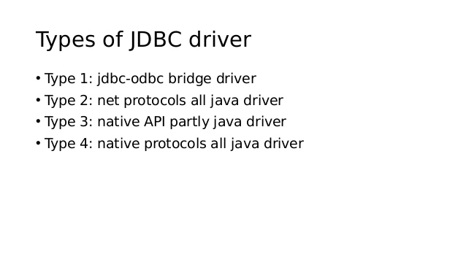
exceptions

Slide 45
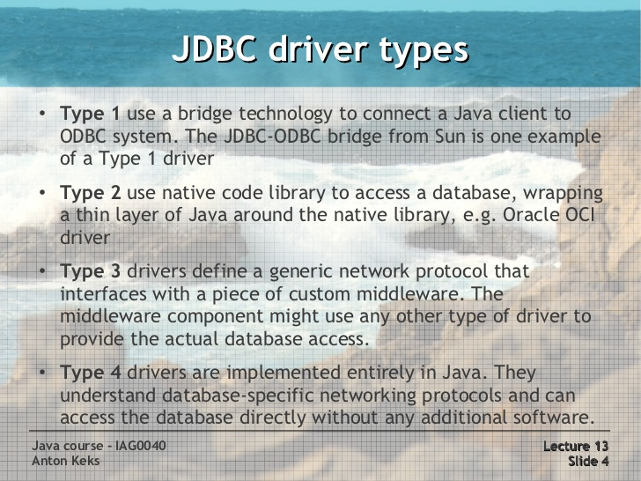
exceptions

Slide 46
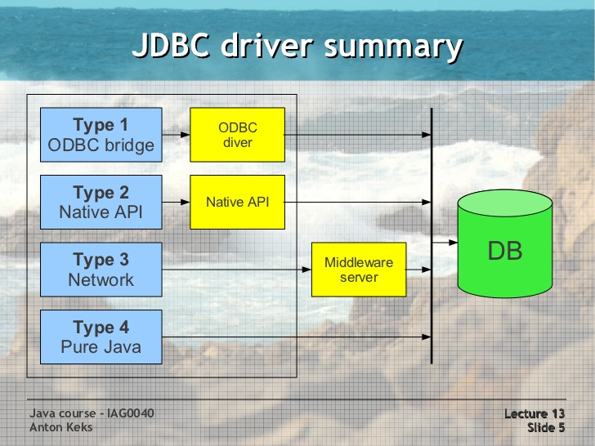
exceptions

Slide 47
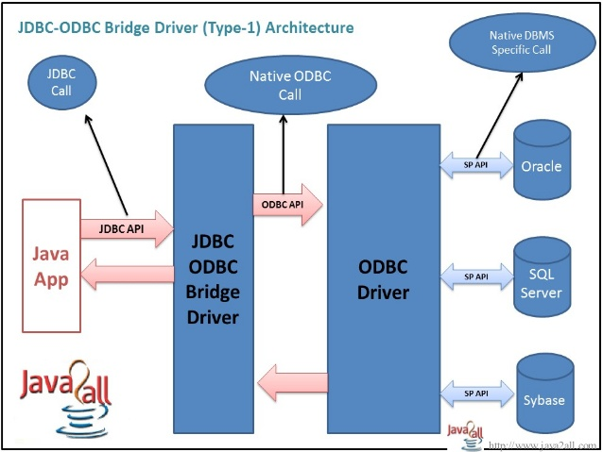
exceptions

Slide 48
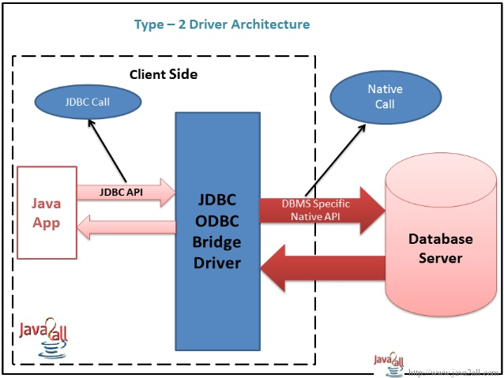
exceptions

Slide 49
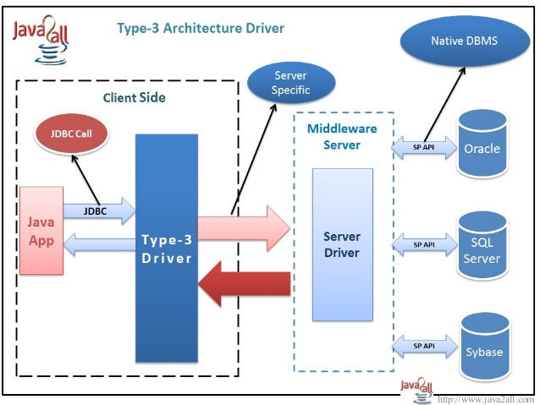
exceptions

Slide 50
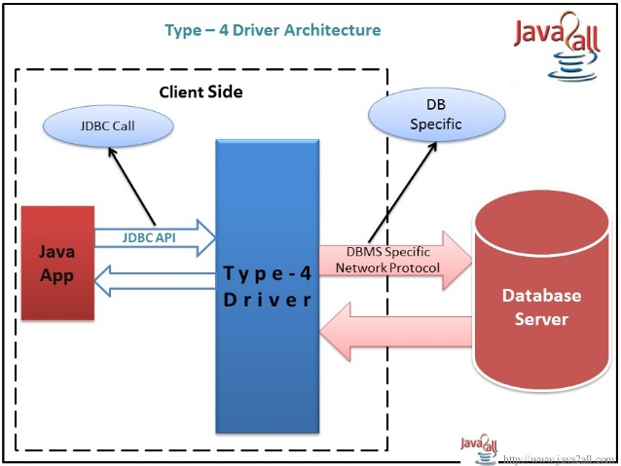
exceptions

Slide 51
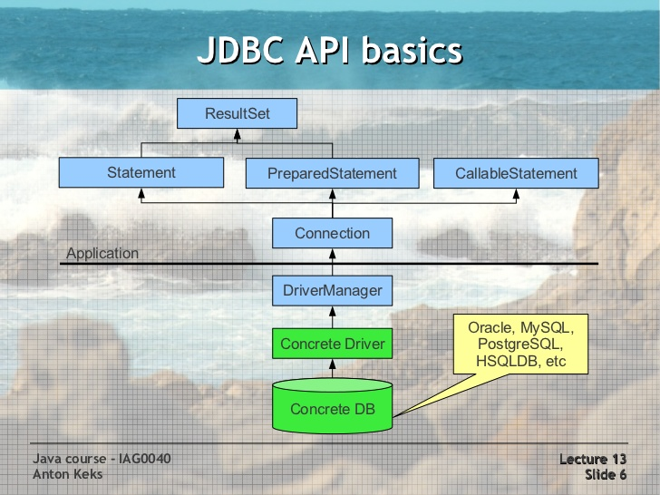
exceptions

Slide 52
exceptions
ResultSet and Cursors
The rows that satisfy the conditions of a query are called the result set.
The number of rows returned in a result set can be zero, one, or many.
A user can access the data in a result set one row at a time, and a cursor provides the means to do that.
A cursor can be thought of as a pointer into a file that contains the rows of the result set, and that pointer has the ability to keep track of which row is currently being accessed.
Most DBMSs create a cursor automatically when a result set is generated.
Result set's cursor can be moved both forward and backward and also allowing it to move to a specified row or to a row whose position is relative to another row.

Slide 53
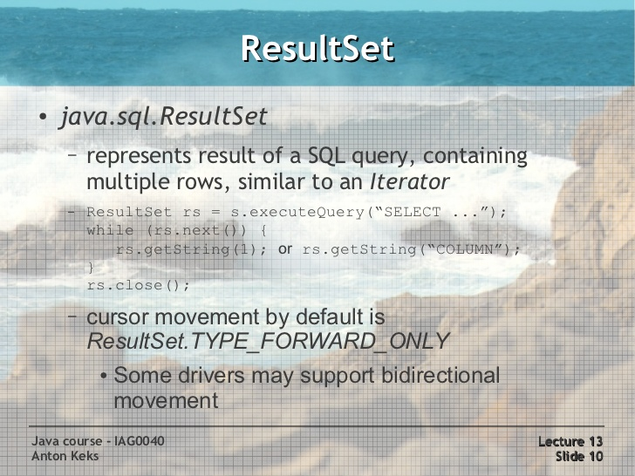
exceptions

Slide 54
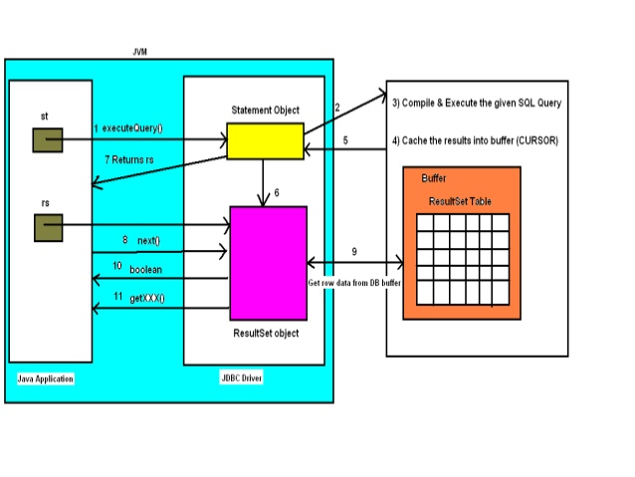
exceptions

Slide 55
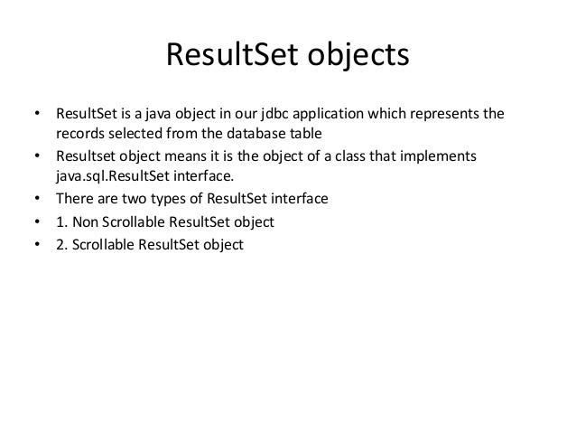
exceptions

Slide 56
exceptions
Result Set
TYPE_FORWARD_ONLY:
The result set cannot be scrolled;
Cursor moves forward only, from before the first row to after the last row.
Contains the rows that satisfy the query at either the time the query is executed or as the rows are retrieved.
This is the default result set created when we create Statement
conn.createStatement()
TYPE_SCROLL_INSENSITIVE:
The result can be scrolled;
its cursor can move both forward and backward relative to the current position, and it can move to an absolute position.
The result set is insensitive to changes made to the underlying data source while it is open
Created with following statement

Slide 57
exceptions
Result Set ….
TYPE_SCROLL_SENSITIVE:
The result can be scrolled; its cursor can move both forward and backward relative to the current position, and it can move to an absolute position.
The result set reflects changes made to the underlying data source while the result set remains open.

Slide 58
exceptions
Result Set ….

Slide 59
exceptions
Result Set Concurrency
Determines what level of update functionality is supported.
CONCUR_READ_ONLY
The ResultSet object cannot be updated using the ResultSet interface
CONCUR_UPDATABLE
The ResultSet object can be updated using the ResultSet interface.
Lab22.5: Demonstrating usage of scrollable updated result sets.

Slide 60
exceptions
Cursor Holdability
Calling the method Connection.commit can close the ResultSet objects that have been created during the current transaction.
The ResultSet property holdability gives the application control over whether ResultSet objects (cursors) are closed when commit is called.
HOLD_CURSORS_OVER_COMMIT:
ResultSet cursors are not closed; they are holdable: they are held open when the method commit is called. Holdable cursors might be ideal if your application uses mostly read-only ResultSet objects.
CLOSE_CURSORS_AT_COMMIT:
ResultSet objects (cursors) are closed when the commit method is called. Closing cursors when this method is called can result in better performance for some applications.

Slide 61
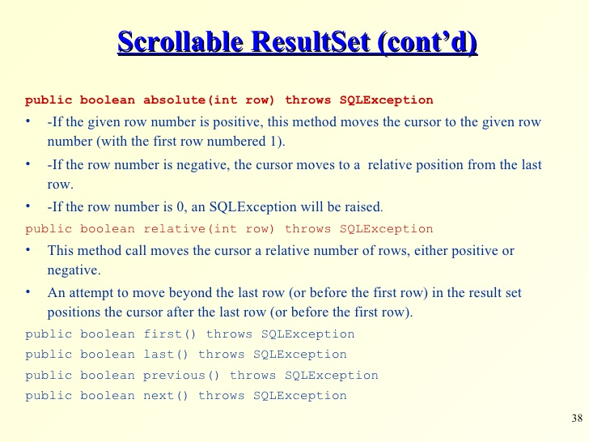
exceptions

Slide 62
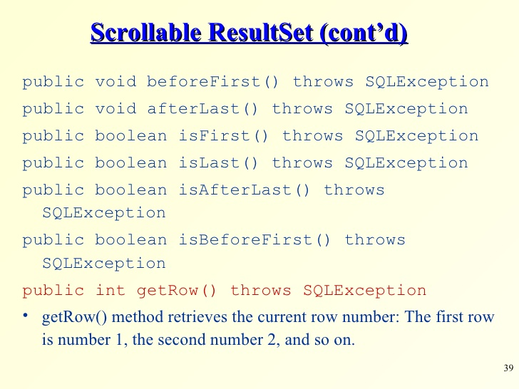
exceptions

Slide 63
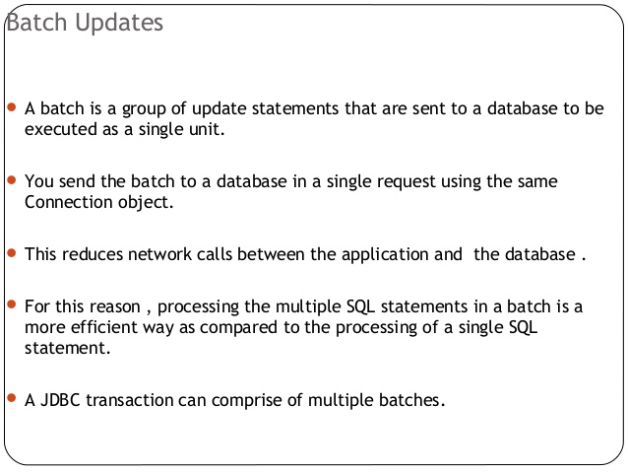
exceptions

Slide 64

exceptions

Slide 65

exceptions

Slide 66

exceptions

Slide 67

exceptions

Slide 68
exceptions

Slide 69
exceptions

Slide 70
exceptions

Slide 71
exceptions

Slide 72
exceptions

Slide 73

exceptions

Slide 74

exceptions

Slide 75

exceptions

Slide 76

exceptions
Lab22.6: Demonstrating Batch update.

Slide 77
exceptions

Slide 78
exceptions

Slide 79

exceptions

Slide 80
exceptions

Slide 81

exceptions

Slide 82

exceptions

Slide 83

exceptions

Slide 84

exceptions

Slide 85

exceptions

Slide 86

exceptions

Slide 87

exceptions

Slide 88

exceptions

Slide 89

exceptions

Slide 90

exceptions

Slide 91

exceptions

Slide 92

exceptions

Slide 93

exceptions

Slide 94

exceptions

Slide 95

exceptions

Slide 96

exceptions

Slide 97

exceptions

Slide 98

exceptions

Slide 99

exceptions

Slide 100

exceptions

Slide 101

exceptions

Slide 102

exceptions

Slide 103

exceptions

Slide 104

exceptions

Slide 105
exceptions

Slide 106
exceptions

Slide 107

exceptions

Slide 108

exceptions

Slide 109

exceptions

Slide 110

exceptions
Transaction: Disabling auto-commit:
Lab22.7: Demonstrating Transactions.

Slide 111
exceptions
Transaction Locks:
Lock :
Mechanism that prohibits two transactions from manipulating the same data at the same time.
Table Lock:
Prevents a table from being dropped if there is an uncommitted transaction on that table.
Row Lock:
A row lock prevents two transactions from modifying the same row, or it prevents one transaction from selecting a row while another transaction is still modifying it.

Slide 112
exceptions
Transaction Locks:
Ex:
Connection con = DriverManager.getConnection(url);
DatabaseMetaData dbmd = con.getMetaData();
if (dbmd.supportsTransactionIsolationLevel(TRANSACTION_SERIALIZABLE)
{ con.setTransactionIsolation(TRANSACTION_SERIALIZABLE); }
con.setAutoCommit(false);
// doing the transactional tasks
con.commit();

Slide 113
exceptions
Transaction Save Points:
SavePoint gives additional Transaction control.
Defines a logical rollback point within a transaction. If an error occurs past a savepoint, we can use the rollback method to undo either all the changes or only the changes made after the savepoint.
Ex:
Savepoint save1 = con.setSavepoint();
Lab22.8: Demonstrating Transaction Save Point.

Slide 114
exceptions
RowSet
RowSet object holds tabular data in a way that makes it more flexible and easier to use than a result set.
Derived from the ResultSet interface.
Functions as Java Bean component.
All RowSet objects have properties. A property is a field that has corresponding getter and setter methods.
RowSet objects use the JavaBeans event model, in which registered components are notified when certain events occur
A cursor movement
The update, insertion, or deletion of a row
A change to the entire RowSet contents
A RowSet object is scrollable and updatable by default.
Effectively make the result set scrollable and updatable even though the DBMS doesn’t support this for the resultset.

Slide 115
exceptions
RowSet Types
Connected RowSet : Always connecte to database, same as resultset.
JdbcRowSet
Disconnected RowSet : Doesn’t maintain connection to the database.
CachedRowSet
WebRowSet
JoinRowSet
FilteredRowSet

Slide 116
exceptions
JdbcRowSet

Slide 117

exceptions

Slide 118

exceptions

Slide 119

exceptions

Slide 120
exceptions

Slide 121
exceptions

Slide 122
exceptions

Slide 123
exceptions

Slide 124
exceptions

Slide 125
exceptions

Slide 126
exceptions

Slide 127
exceptions

Slide 128
exceptions

Slide 129
exceptions

Slide 130
exceptions

Slide 131

exceptions

Slide 132
exceptions

Slide 133
exceptions

Slide 134
exceptions
Running Eclipse

Slide 135
exceptions
References:
http://www.slideshare.net/itsec/jdbc-tutorial
http://www.slideshare.net/myrajendra/interface-result-set
http://www.slideshare.net/antonkeks/java-course-13-jdbc-db-access
http://www.slideshare.net/itsec/jdbc-java-database-connectivity-4071670
http://www.slideshare.net/becoolever/connection-pooling
http://www.journaldev.com/2509/jdbc-datasource-example-oracle-mysql-and-apache-dbcp-tutorial
http://www.slideshare.net/vikasjagtap3/jdbc-ppt-44534221
http://www.slideshare.net/nakov/svetlin-nakov-database-transactions

Slide 136
Java - miscellaneous
Type Comparison Operator instanceof
The instanceof operator compares an object to a specified type.
You can use it to test if an object is an instance of a class, an instance of a subclass, or an instance of a class that implements a particular interface
Classes implementing interfaces
class MyClass extends MySuperClass implements YourInterface {
// field, constructor, and
// method declarations
}

Slide 137
Java - miscellaneous
Varargs – Specifying Arbitrary number of arguments
public Polygon polygonFrom(Point... corners) {
int numberOfSides = corners.length;
double squareOfSide1, lengthOfSide1;
squareOfSide1 = (corners[1].x - corners[0].x)
* (corners[1].x - corners[0].x)
+ (corners[1].y - corners[0].y)
* (corners[1].y - corners[0].y);
lengthOfSide1 = Math.sqrt(squareOfSide1);
// more method body code follows that creates and returns a
// polygon connecting the Points
}
You will most commonly see varargs with the printing methods; for example, this printf method:
public PrintStream printf(String format, Object... args)
allows you to print an arbitrary number of objects. It can be called like this:
System.out.printf("%s: %d, %s%n", name, idnum, address);

Slide 138

Java - miscellaneous
Returning a Class or Interface
When a method uses a class name as its return type the class of the type of the returned object must be either a subclass of, or the exact class of, the return type.
public Number returnANumber() {
...
}
The returnANumber method can return an ImaginaryNumber but not an Object. ImaginaryNumber is a Number because it's a subclass of Number. However, an Object is not necessarily a Number — it could be a String or another type

Slide 139
Advanced java
Garbage collection
JDBC
Lambda expressions
Annotations
Aggregate operations on collection using Lambarda expression.
Java streaming
Blocking queue
Aggregate operations
Autoboxing and unboxing

Slide 140
https://docs.oracle.com/javase/tutorial/reallybigindex.html
http://www.slideshare.net/EdurekaIN/java-class-3
http://www.slideshare.net/abdurrehmanabdurrehman391/variables-and-data-types-by-sir-khalid
http://www.slideshare.net/abdurrehmanabdurrehman391/java-advancedoop
http://www.slideshare.net/MindfireSolutions/java-garbage-collection-how-it-works?next_slideshow=1
http://www.slideshare.net/arnold7490/unit-4-java
http://www.slideshare.net/arnold7490/unit-3-java?next_slideshow=1
http://www.slideshare.net/tushardesarda/java-tutorial-3
http://www.slideshare.net/muralidhar9e/java-exception-handling-ppt
http://www.slideshare.net/emprovise/2-javabasics
http://www.slideshare.net/AllanHuang/java-new-evolution
http://www.slideshare.net/antonkeks/4-collections
http://www.slideshare.net/andreaiacono/java8-39841939 - Java8 features
http://www.slideshare.net/AbhishekKhune/07-java-collection
http://www.slideshare.net/shahjahan786/generics-27960064 - Generics
http://www.slideshare.net/caroljmcdonald/java-generics-2485138?next_slideshow=1

Slide 141
http://www.slideshare.net/KavitaGanesan/is-66154415-kavitaganesanv2 - Strings
http://www.slideshare.net/antonkeks/10-threads - Threads
http://www.slideshare.net/BenjDelMundo/java-thread-synchronization - Synchronization
http://www.slideshare.net/javaonkar/thread-concurrancy - Synchronization
http://www.slideshare.net/lineking/io-package - Basic IO
http://new.51cto.com – Buffered streams.
http://www.slideshare.net/EmertxeSlides/010-core-javaiofundamentals - IO
http://www.slideshare.net/martyhall/file-io-in-java-8-applying-the-power-of-streams - File IO
http://www.slideshare.net/boulderjug/55-things-in-java-7 - File IO

